Slide 1
From ReactJS to React Native
B02901017 陳璽文

Slide 2
Outline
Why we use React
File structure
Life Cycle
ReactJS vs React Native
DEMO

Slide 3
Why we use React
In React, only when the event occurs, state has changed, then, React automatically call render to update the UI. State becomes the event and the transition between render.
Each event does not need to worry about which part of the DOM changes, they only need to set the state on it.
Correspondingly, when you write the render , you only need to worry about what the current state is.
React in the various UI components independent, is conducive to improving the reuse of UI components while reducing the coupling of each UI components

Slide 4
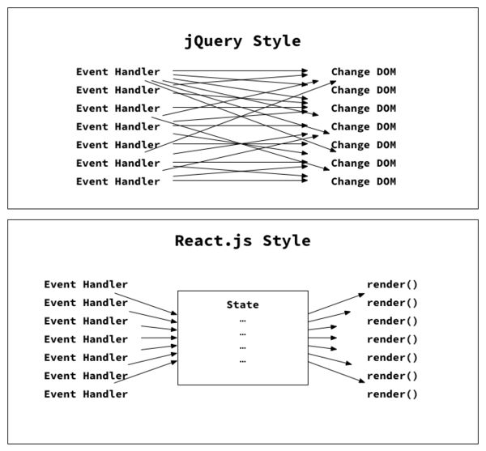

Slide 5
File structure
App
Front End
Back End
static
server.js
src
server.js
src
api
ui
api
model
style
component
container
Index.js

Slide 6
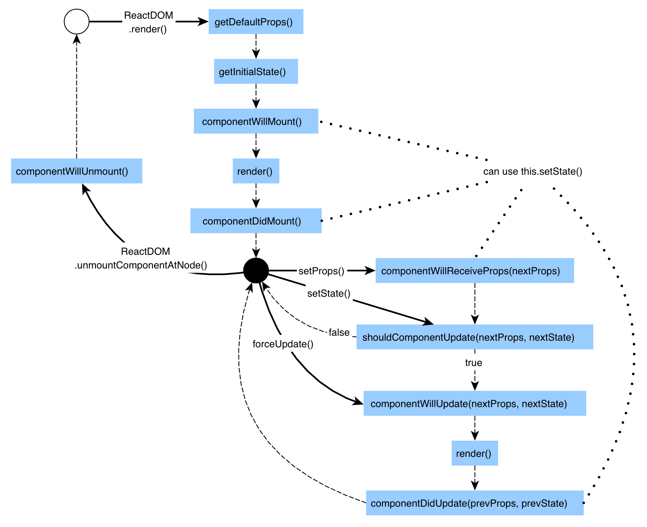

Slide 7
props vs state
props
Use in parent element to pass attribute to child element
state
The component to manage its own status and render the relevant UI .
refs
You can control pass attribute to anywhere in DOM
.

Slide 8
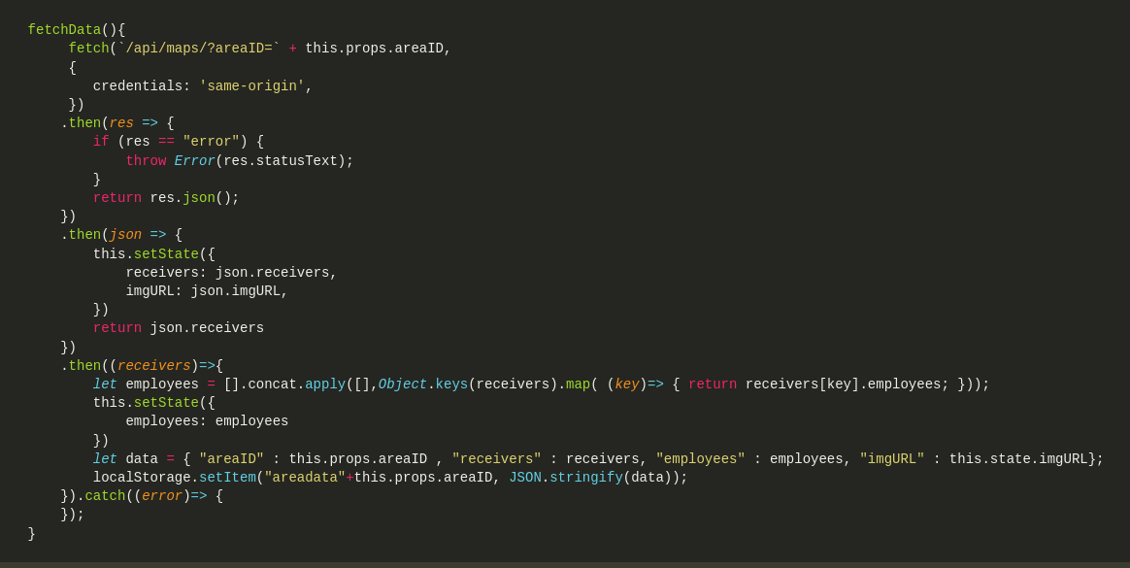
Fetch Data

Slide 9
Life Cycle
componentWillmount():
Check the local storage for some static information, such as token, credential, or even your
history .
render():
Draw the basic layout.
componentDidmount():
Connect to th back end, fetch the data, then refresh the UI

Slide 10
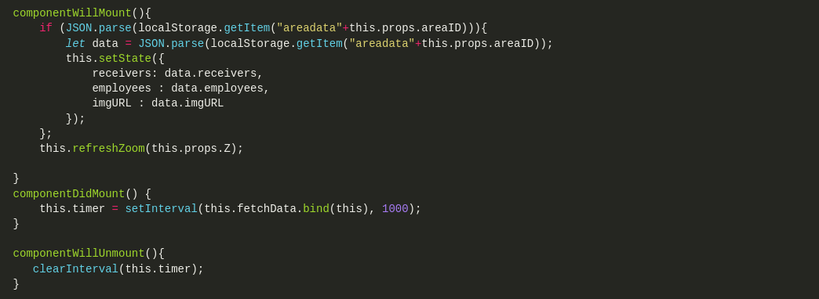
Life Cycle

Slide 11
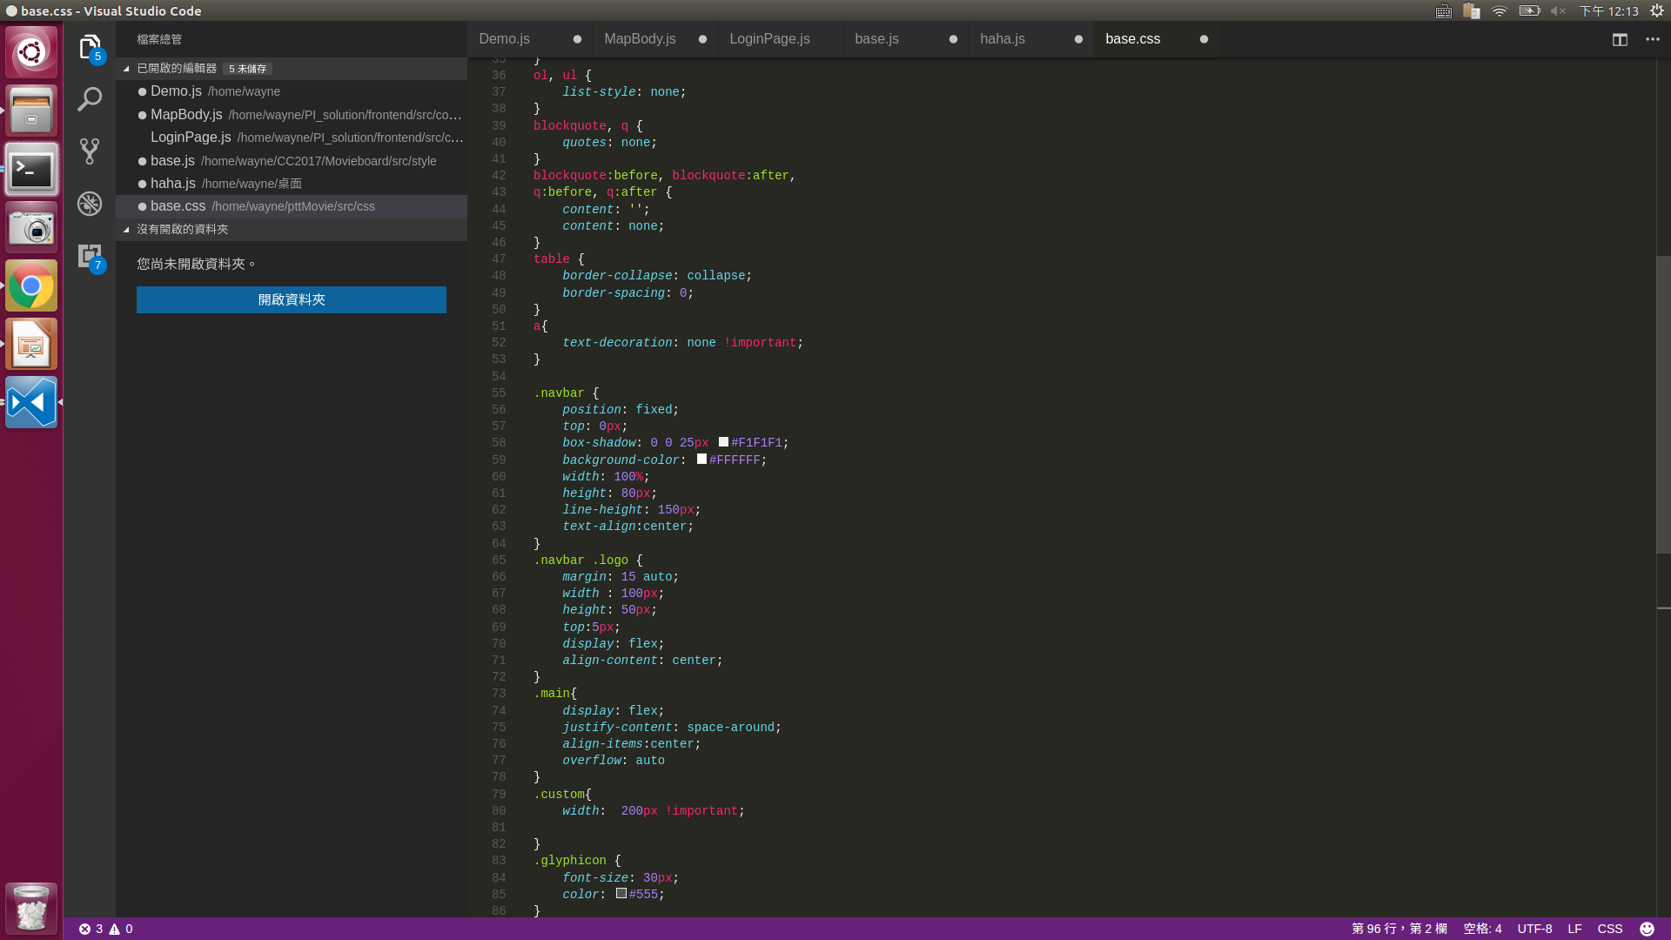
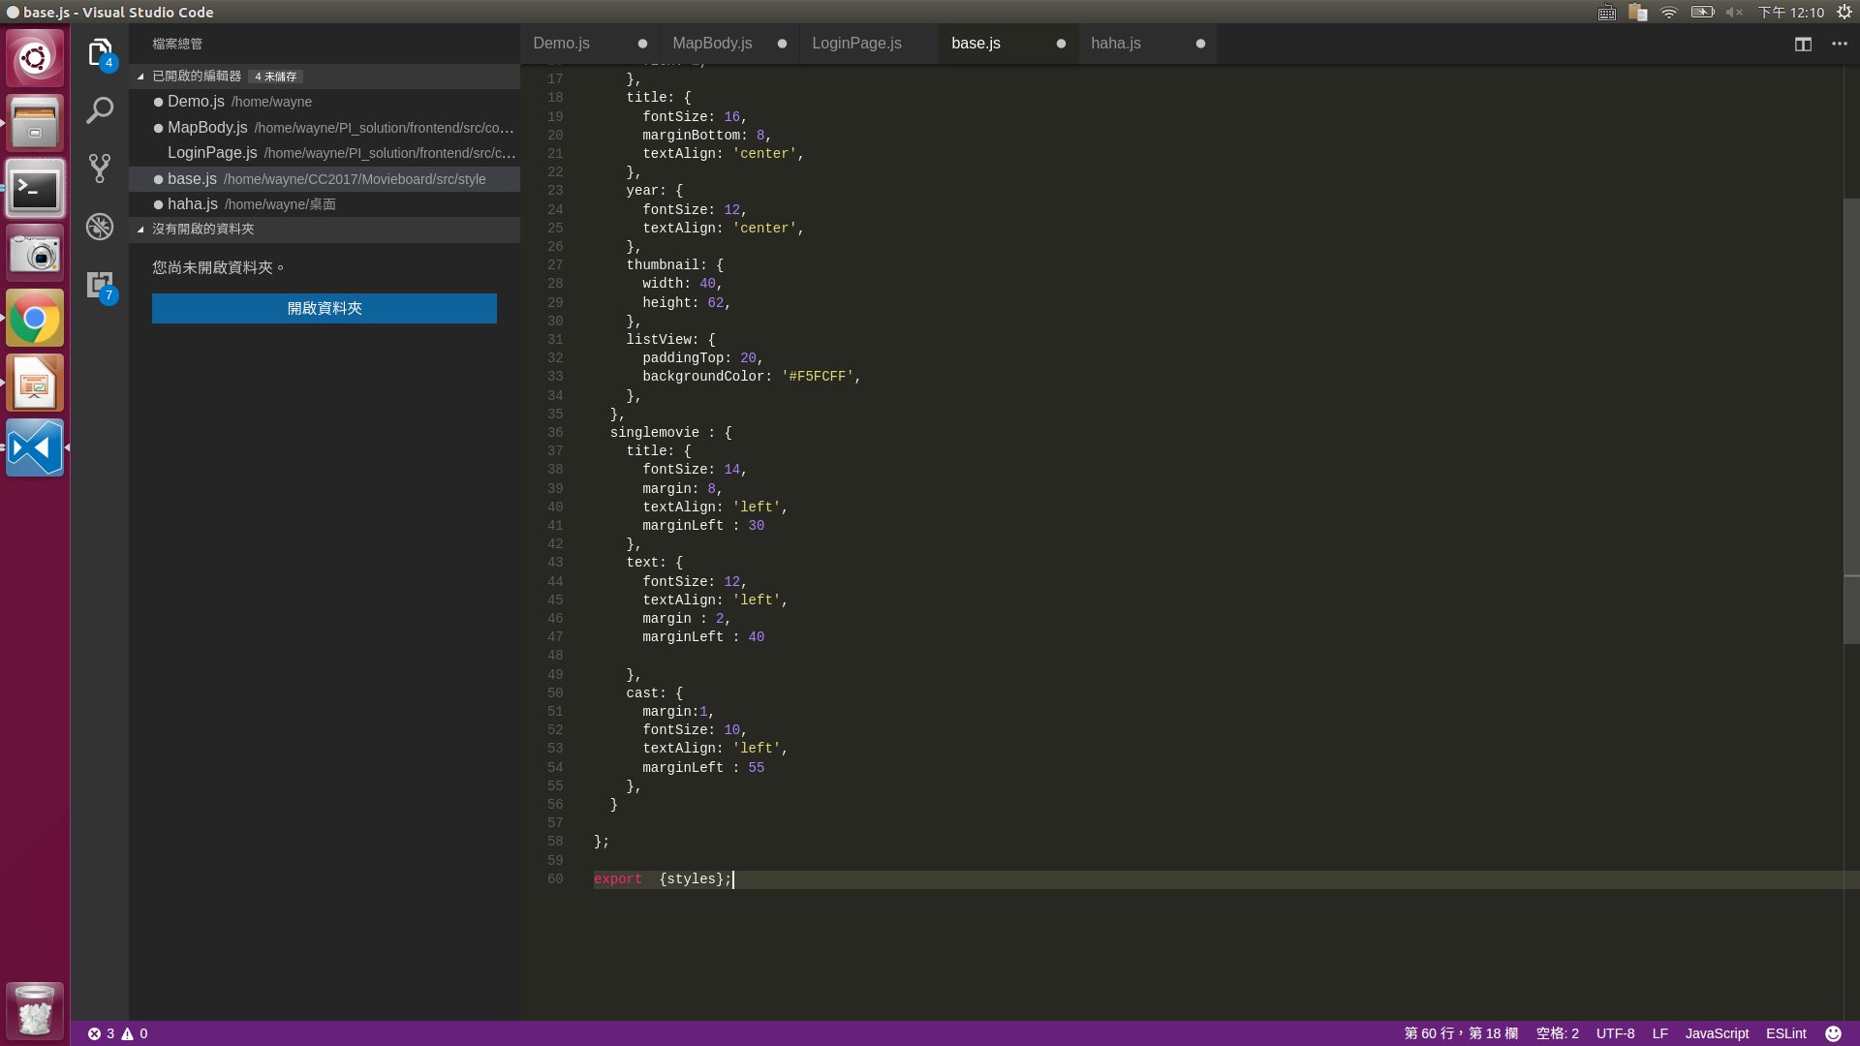
CSS

Slide 12

StyleJS

Slide 13
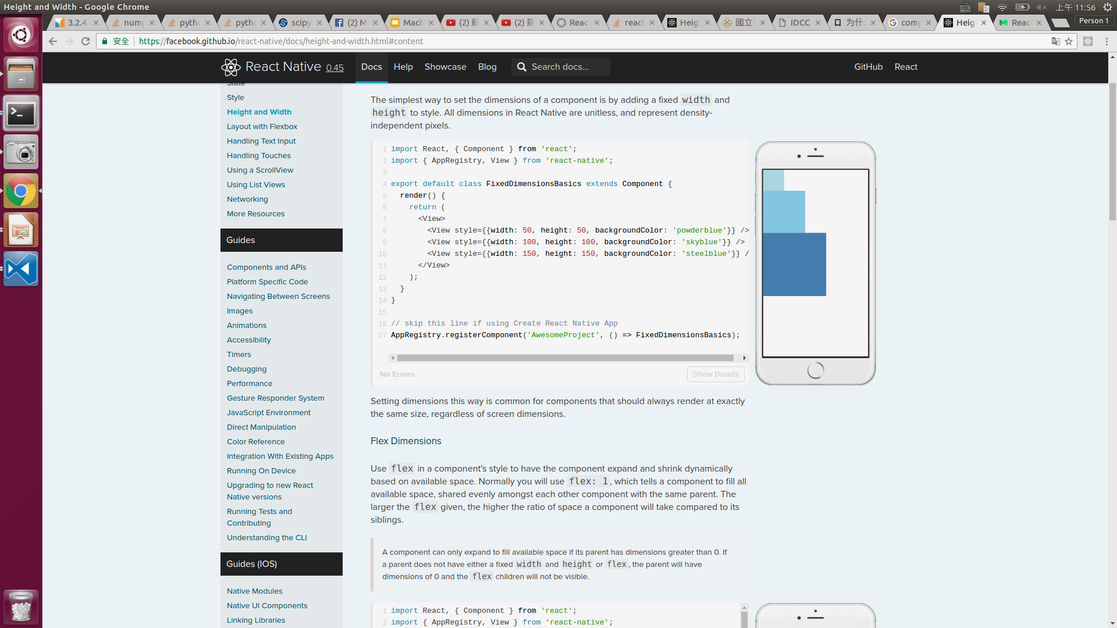
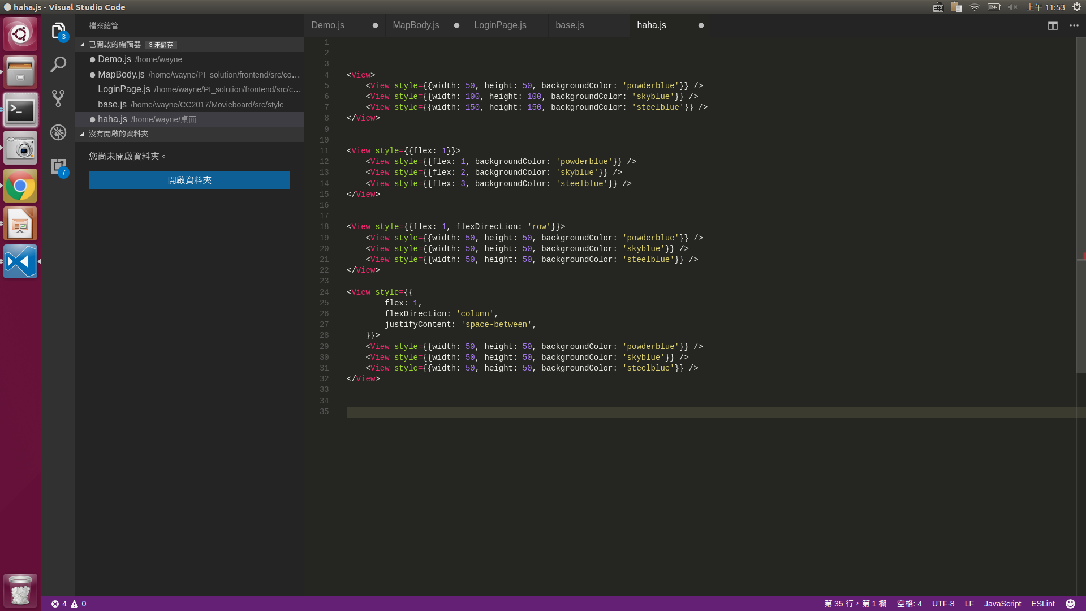
Flex system

Slide 14
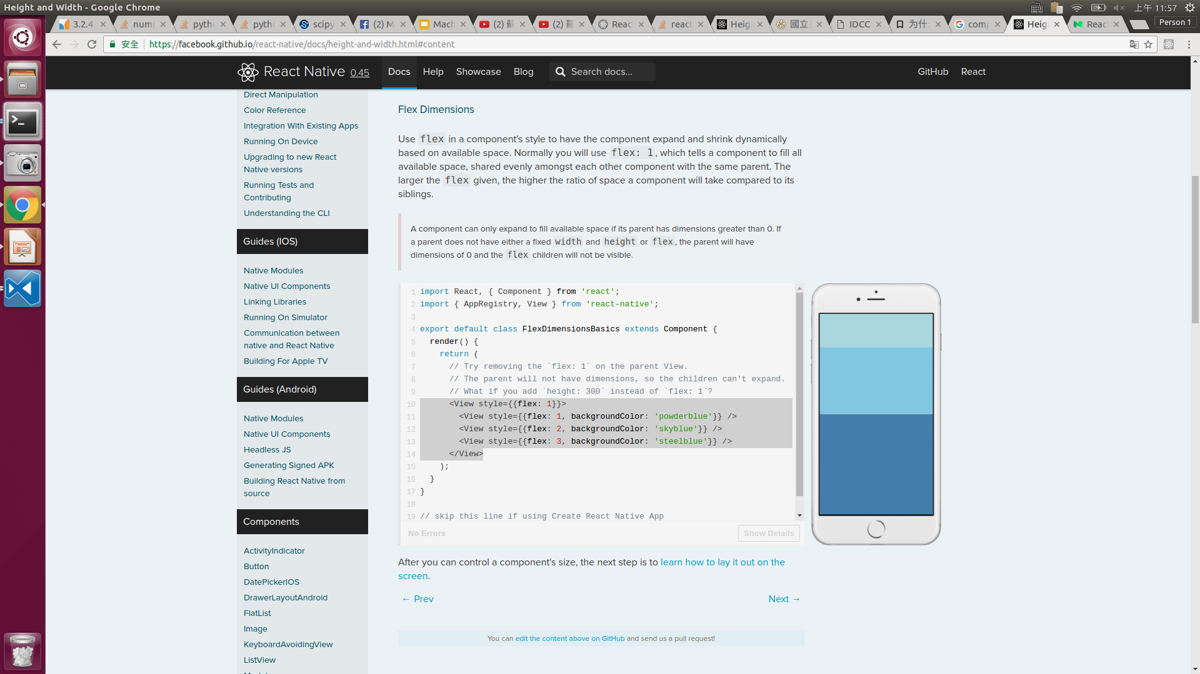
Flex system

Slide 15
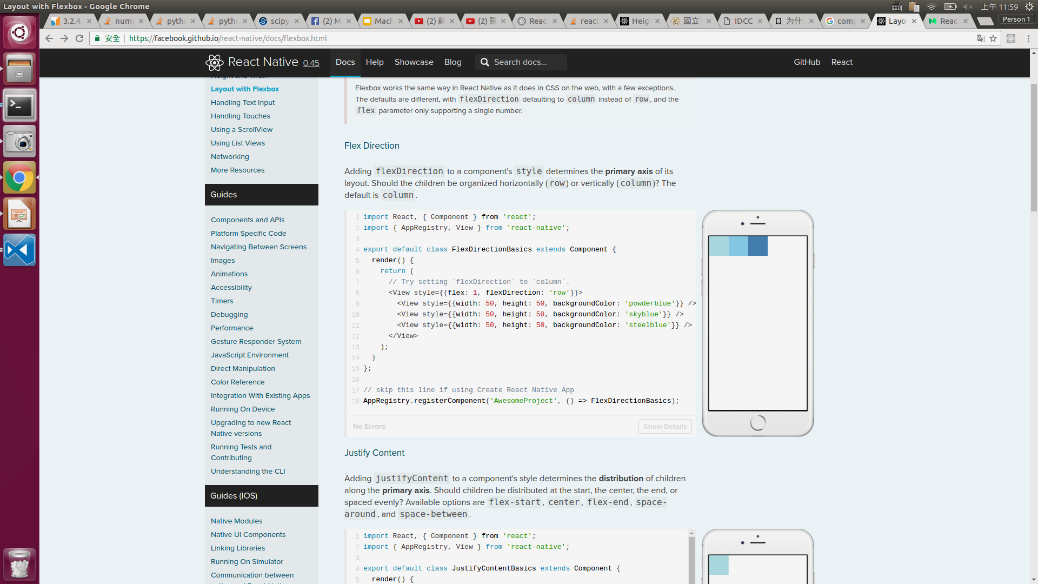
Flex system

Slide 16
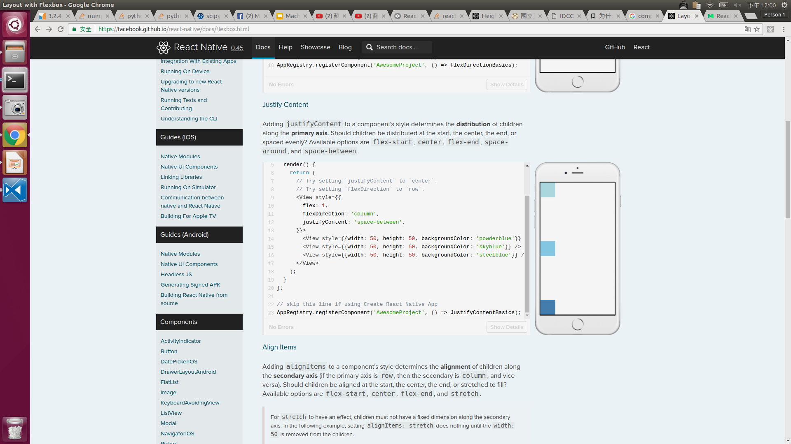
Flex system

Slide 17
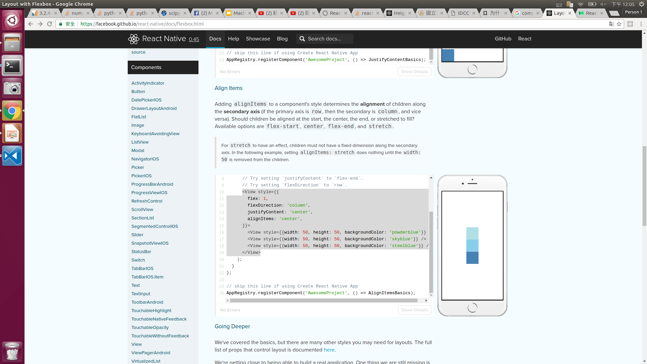
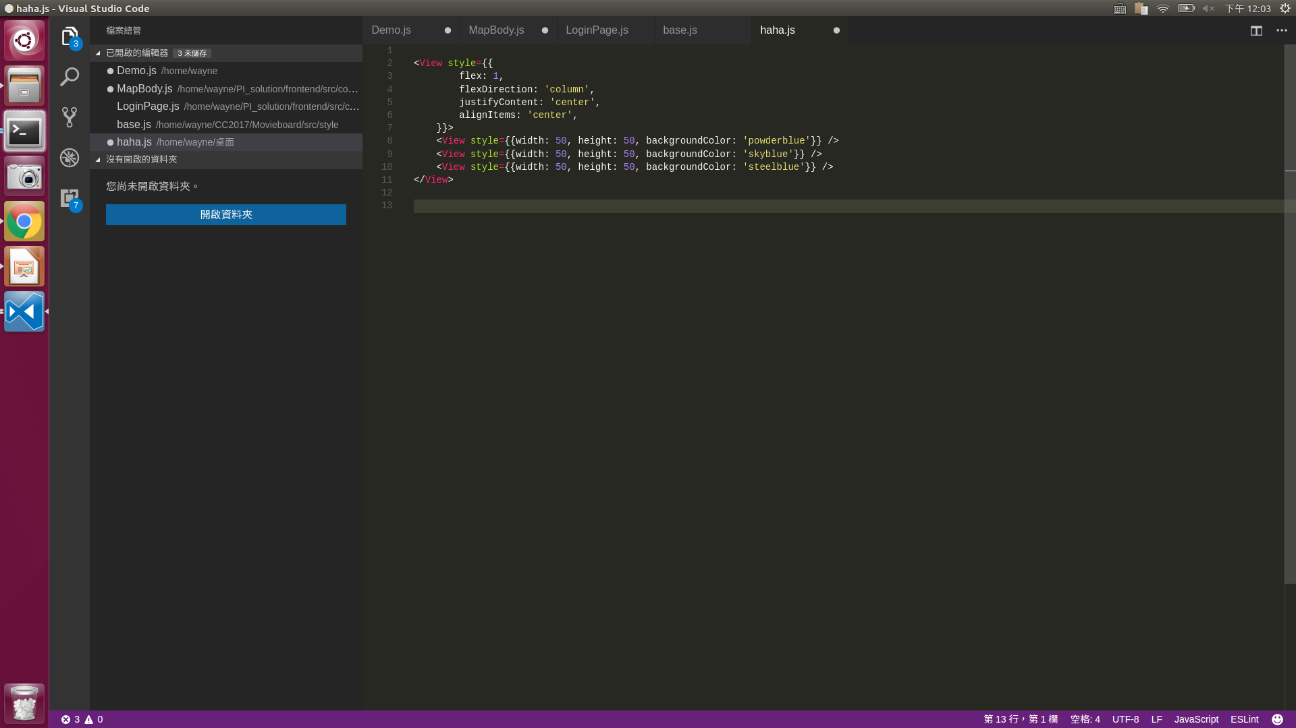
Flex system

Slide 18
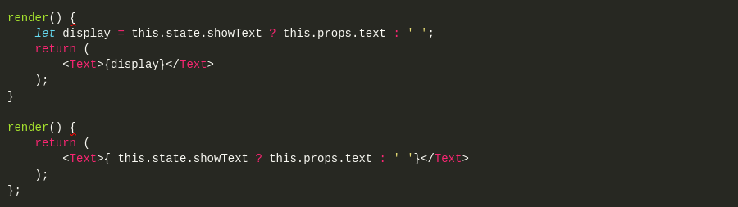
Component Control

Slide 19
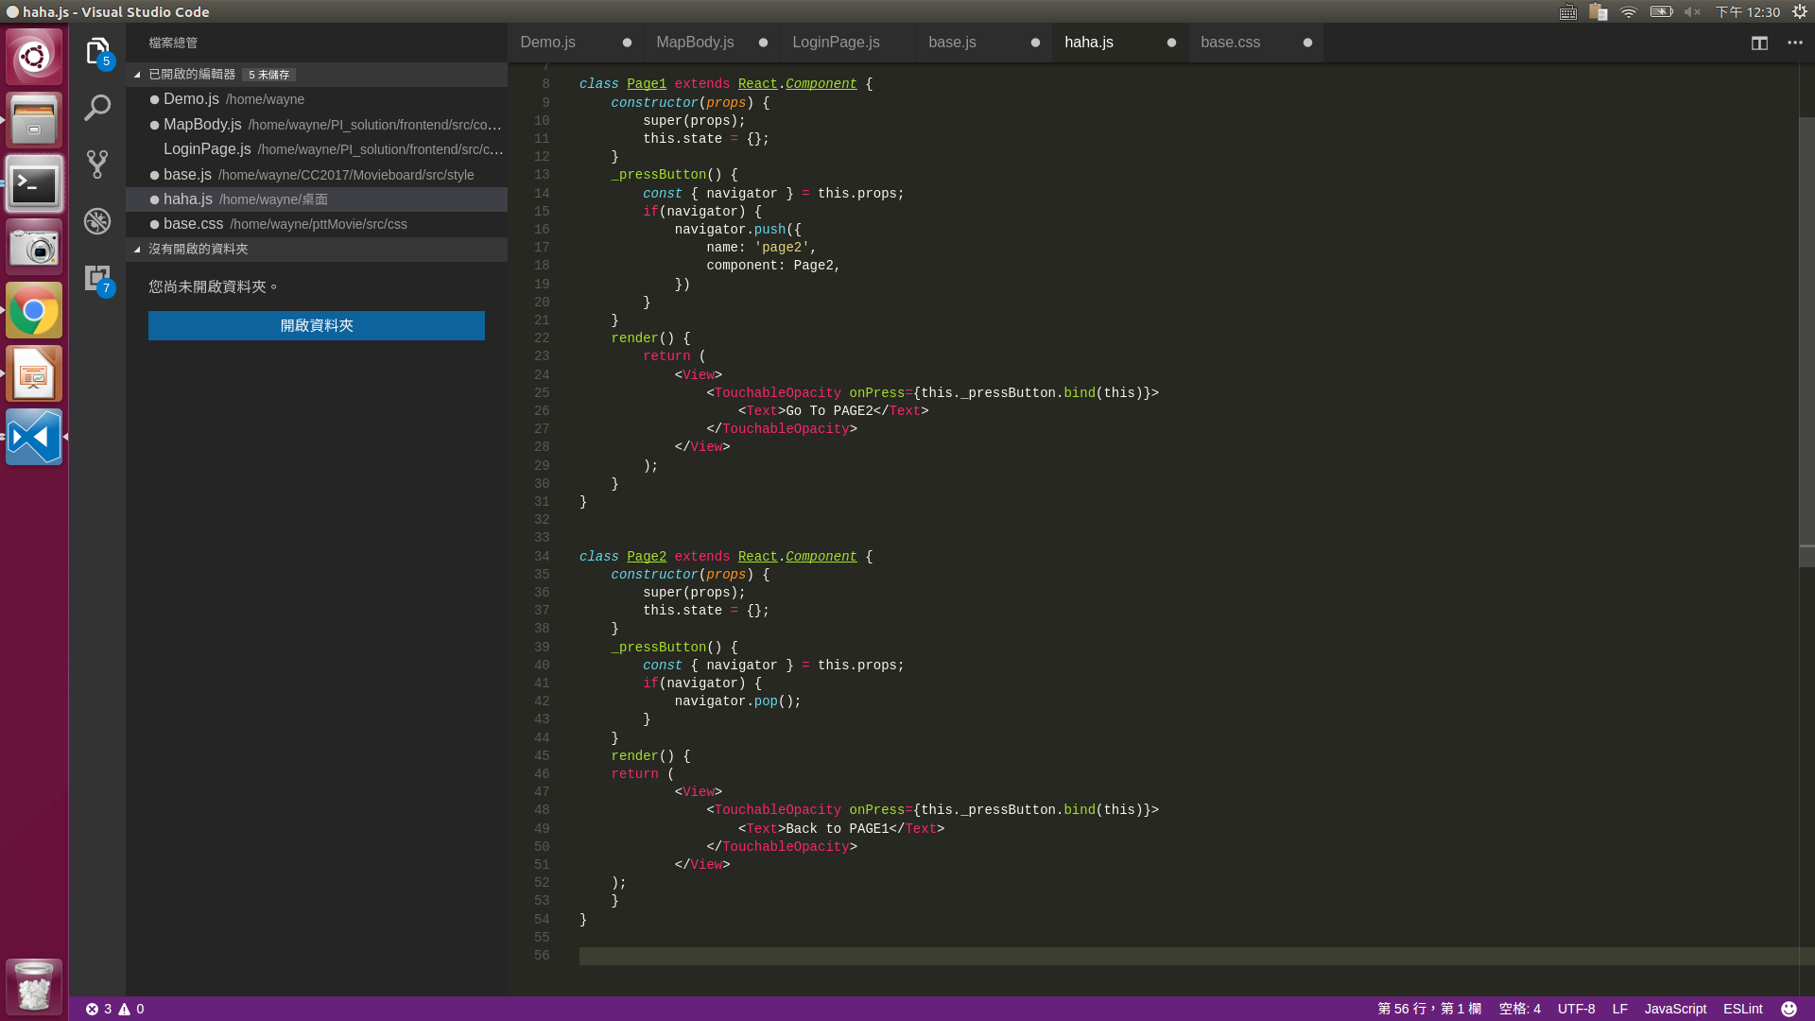
Navigator

Slide 20
Navigator

Slide 21
Navigator

Slide 22
Navigator

Slide 23
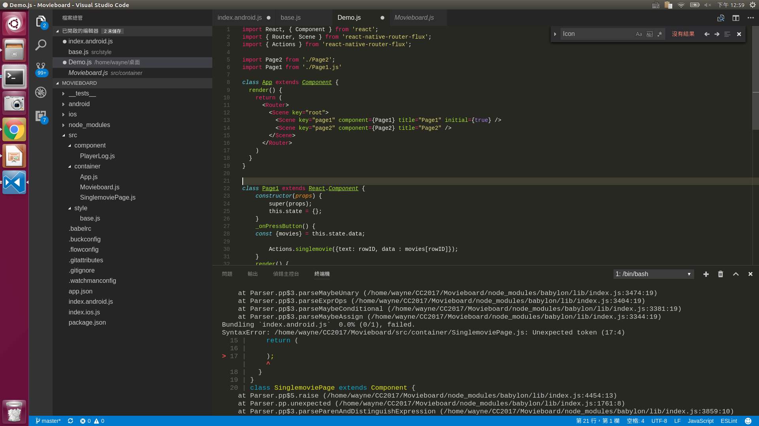
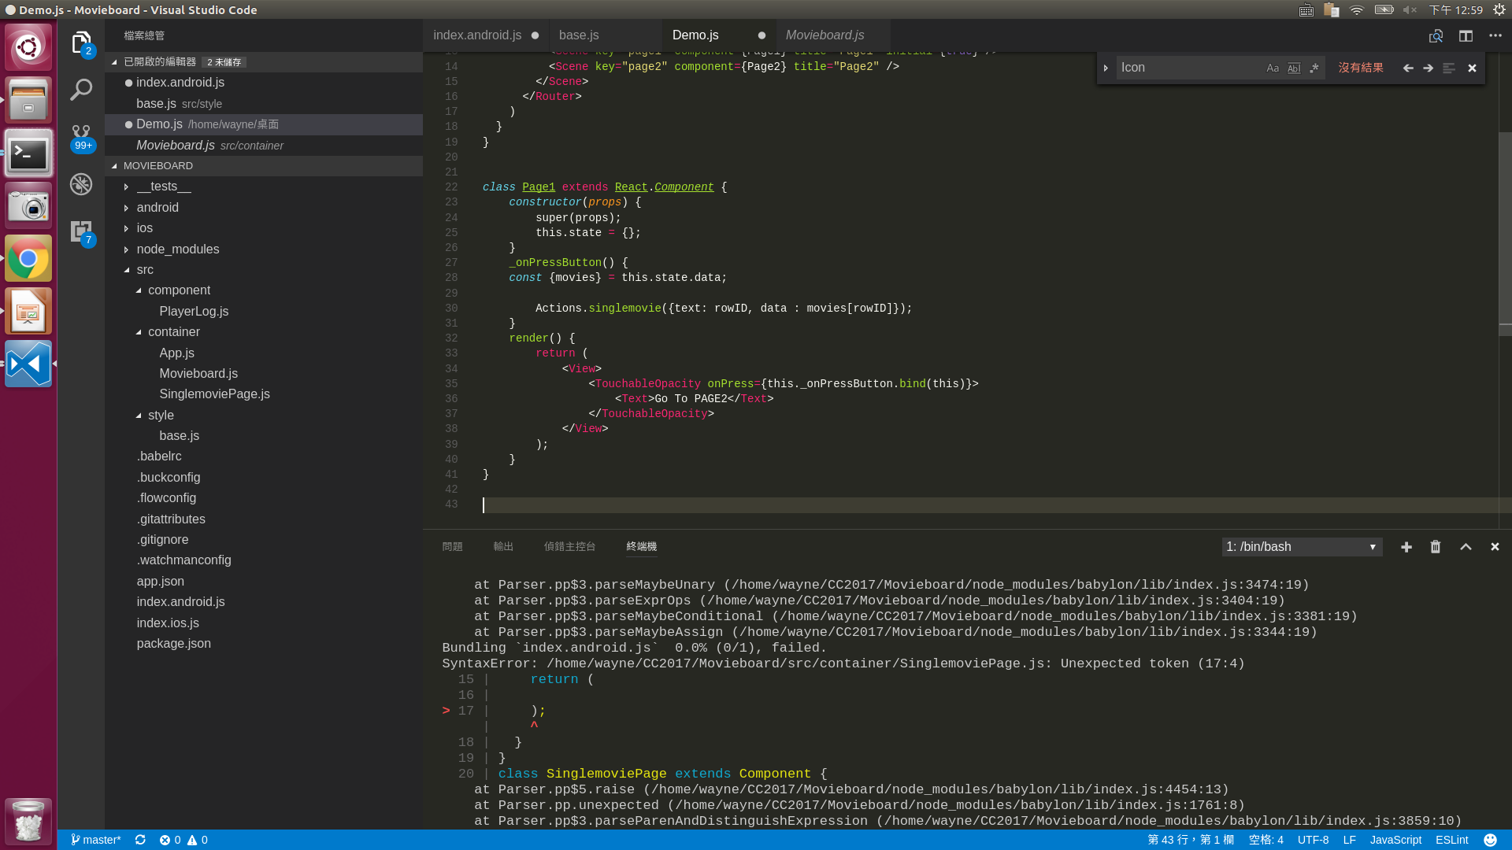
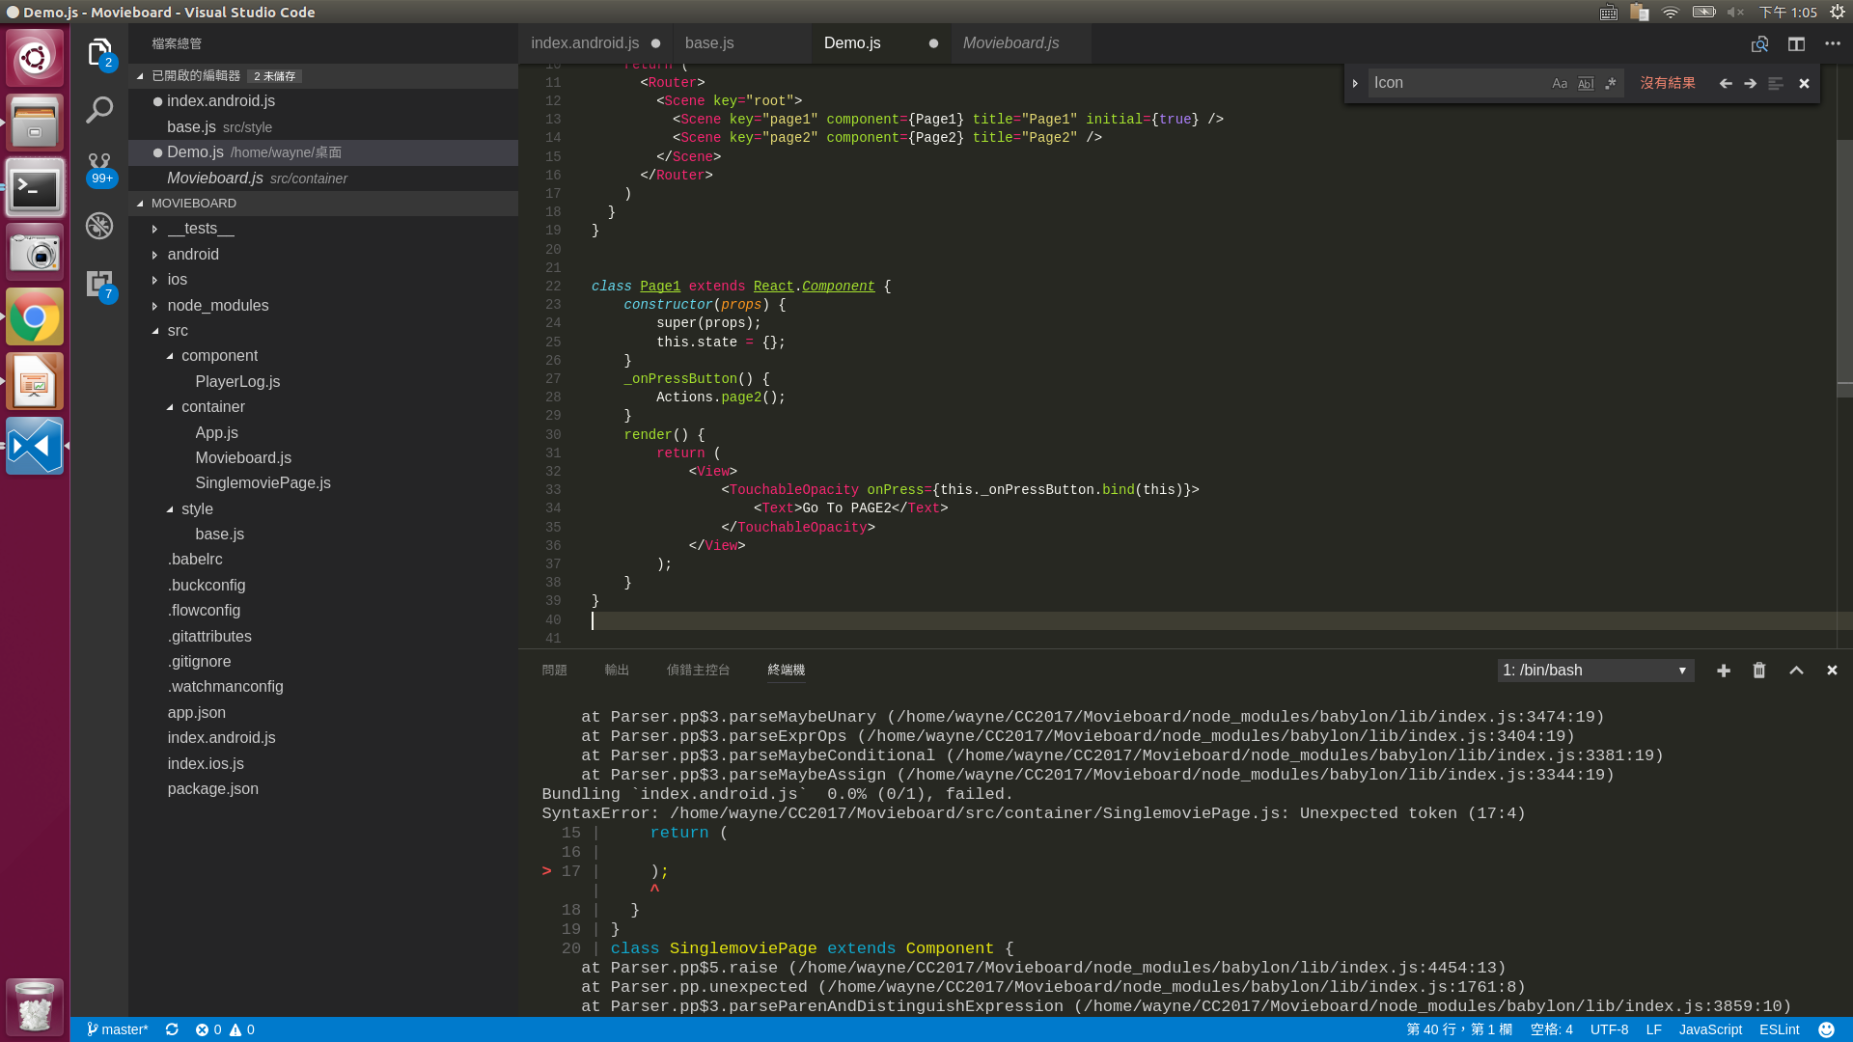
React Router

Slide 24
React Router

Slide 25
React Router

Slide 26
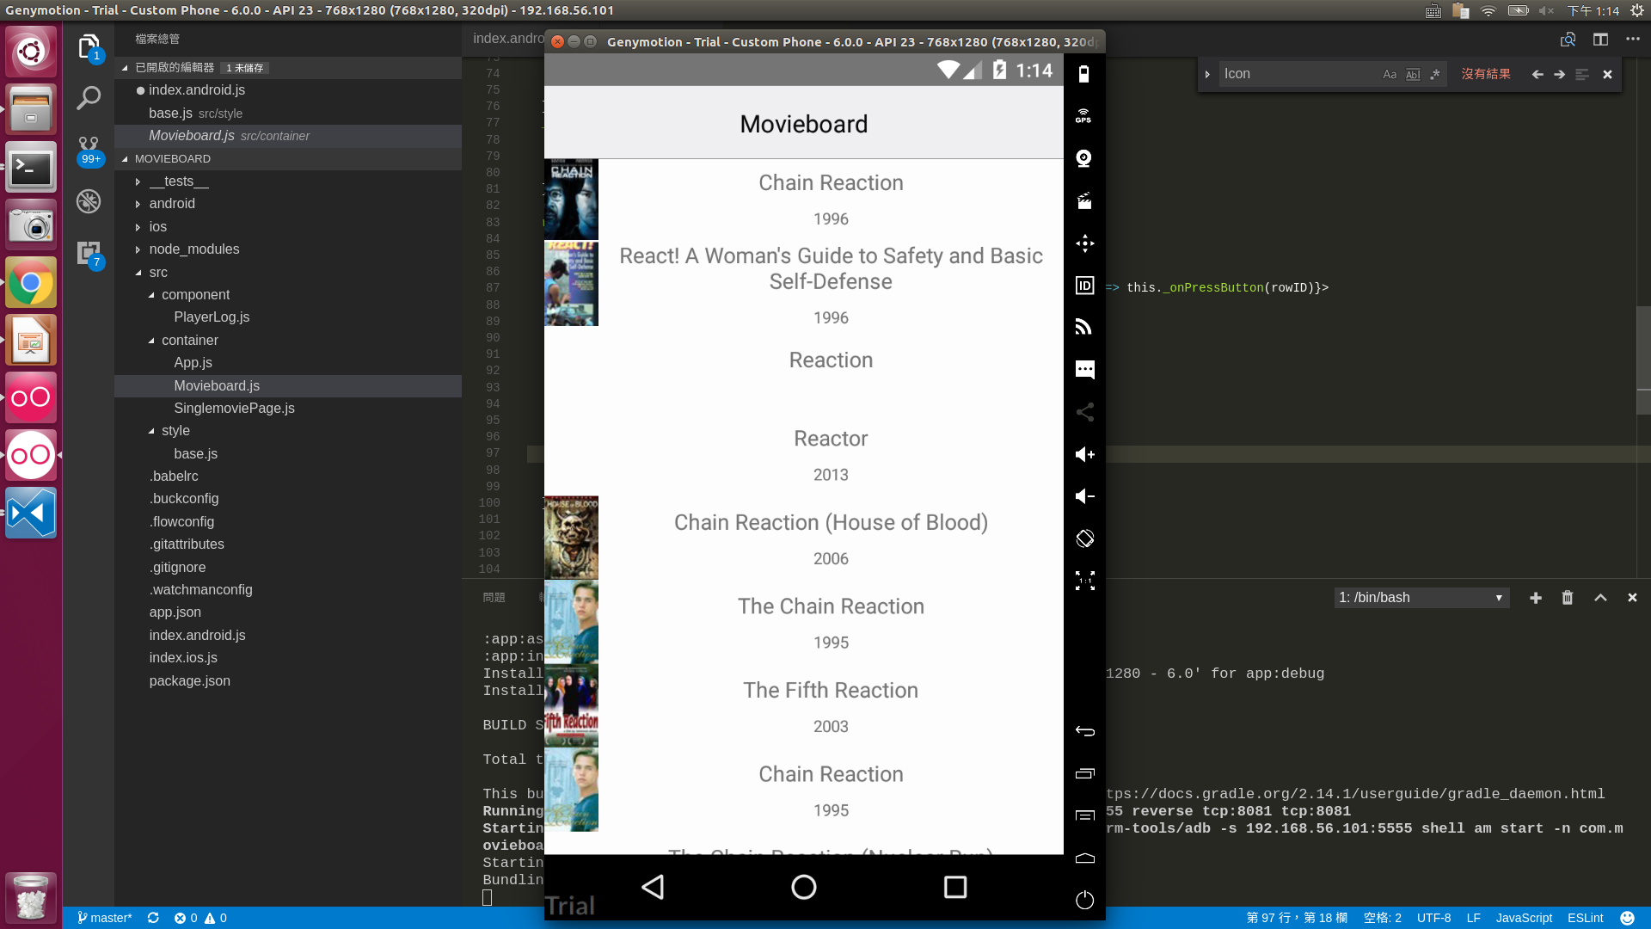
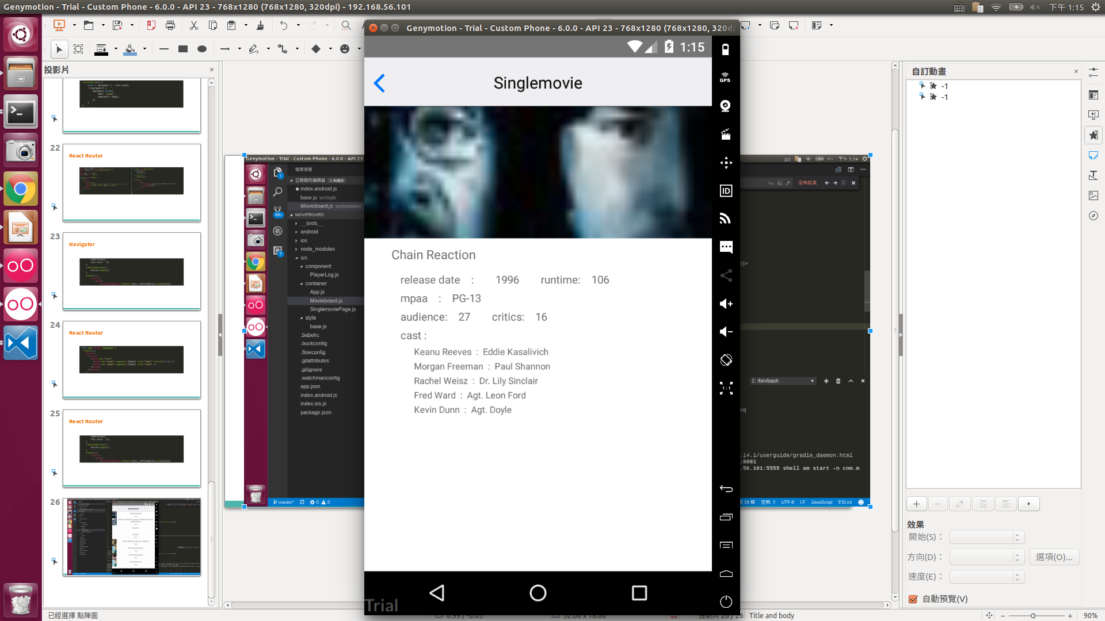
DEMO

